Slide 1
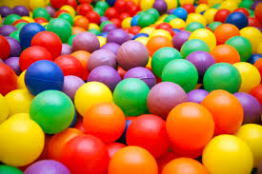

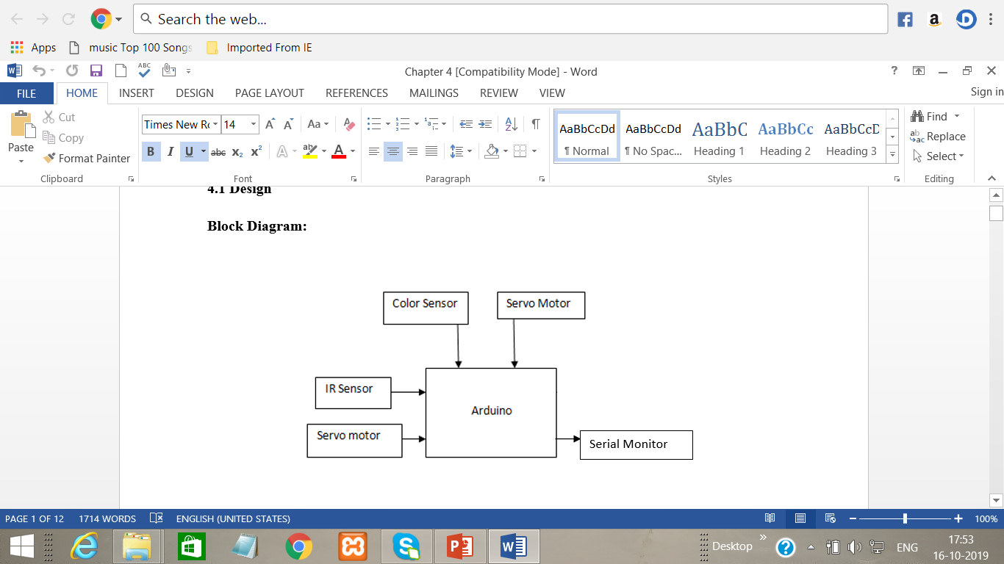
XAVIER INSTITUTE OF ENGINEERING DEPARTMENT OF INFORMATION TECHNOLOGY Internet of things AY-2019-20
COLOUR SORTING MACHINE
Group No 4: SHARLENE MARTIN-29, FRANKLIN MATHIAS-30
Aim: To design a COLOUR SORTING MACHINE prototype using different sensors.
Features:
Provides a smooth conveyer for the objects.
Simplifying the task such as recognizing or differentiating colours.
Large amount of objects of different colours can be sorted quickly.
Using servo motors the implementation becomes easy.
Circuit Diagram/Block Diagram:
Hardware & Software Requirements:
Arduino
Breadboard
Arduino Mega 2560
IR Sensor(LM393)
Colour Sensor(TCS3200)
Servo Motors
Connecting Wires
USB cable
Fiber Board
Coloured Objects
Internet Connection

